Slide 1
Hidden Markov Models project-2
Christian M. Adriano (Chris)
christian.adriano@hpi.de
Notes:
https://en.wikipedia.org/wiki/Transduction_(machine_learning)

Slide 2
Topics
Review of Baum-Welch Algorithm
Example
HMMLearn API
Tasks

Slide 3
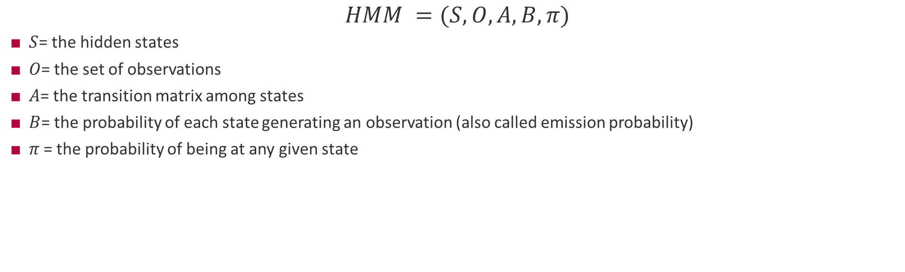
HMM definitions used
$$HMM =(S, O, A, B, π)$$
$S$= the hidden states
$O$= the set of observations
$A$= the transition matrix among states
$B$= the probability of each state generating an observation (also called emission probability)
$π$= the probability of being at any given state
Reference:
Rabiner, L. R. (1989). A tutorial on hidden Markov models and selected applications in speech recognition. Proceedings of the IEEE, 77(2), 257-286.

Slide 4
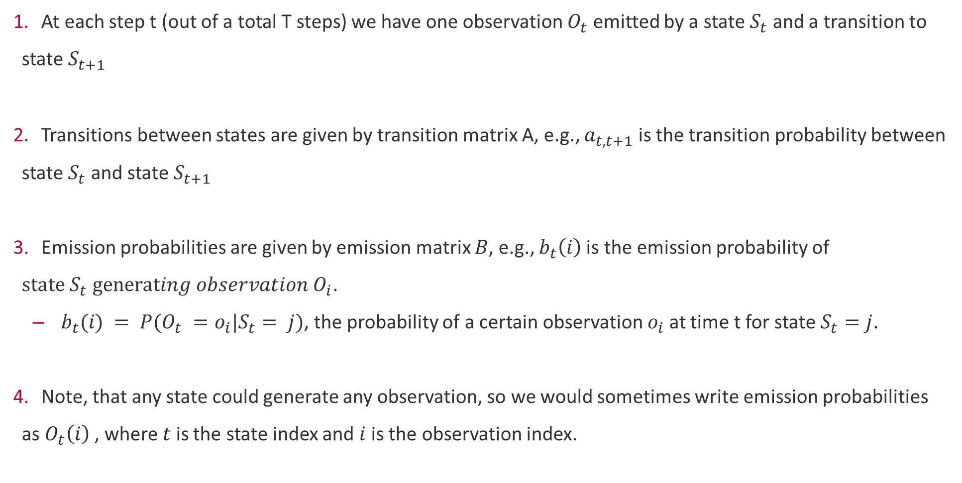
How the HMM works
At each step t (out of a total T steps) we have one observation $O_{t}$ emitted by a state $S_{t}$ and a transition to state $S_{t+1}$
Transitions between states are given by transition matrix A, e.g., $a_{t,t+1}$ is the transition probability between state $S_{t}$ and state $S_{t+1}$
Emission probabilities are given by emission matrix $B$, e.g., $b_{t}\left(i\right)$is the emission probability of $state S_{t} generating observation O_{i}$.
$b_{t}(i) = P(O_{t} =o_{i}|S_{t}= j)$, the probability of a certain observation $o_{i}$ at time t for state $S_{t}=j$.
Note, that any state could generate any observation, so we would sometimes write emission probabilities as $O_{t}\left(i\right)$ , where $t$ is the state index and $i$ is the observation index.

Slide 5
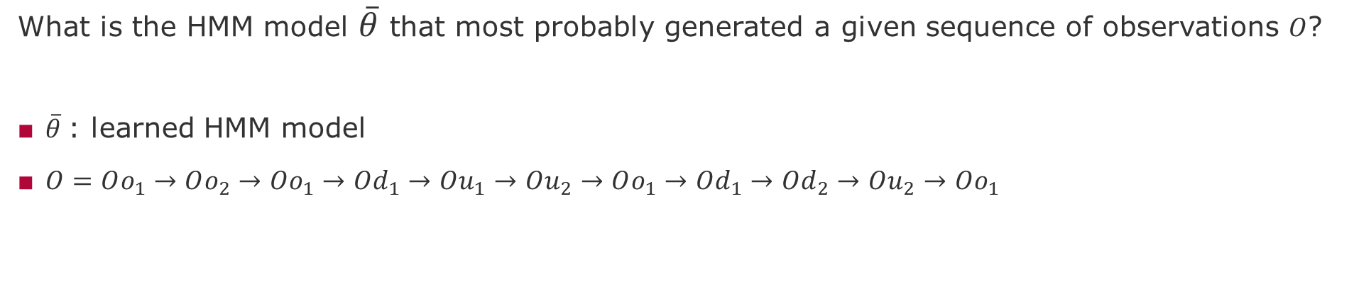
Baum-Welch algorithm GOAL
What is the HMM model $\overline{θ}$ that most probably generated a given sequence of observations $O$?
$\overline{θ}$: learned HMM model
$O=Oo_{1}→Oo_{2}→Oo_{1}→Od_{1}→Ou_{1}→Ou_{2}→Oo_{1}→Od_{1}→Od_{2}→Ou_{2}→Oo_{1}$

Slide 6
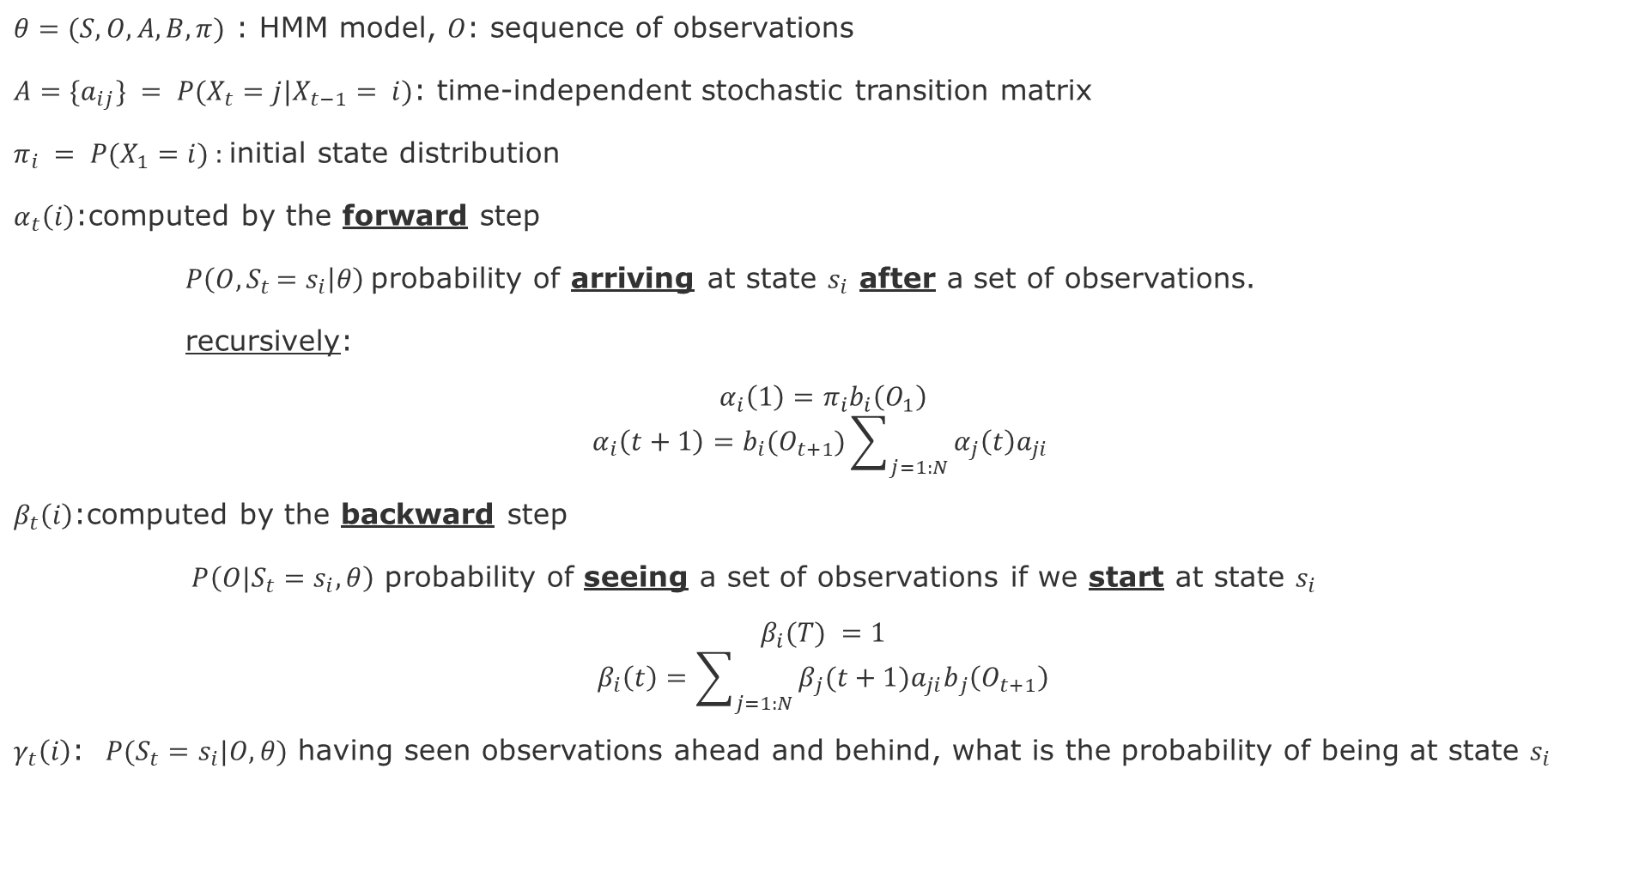
Baum-Welch Algorithm: Components
$θ=(S, O, A,B,π)$ : HMM model, $O$: sequence of observations
$A=\{a_{ij}\} = P(X_{t}=j|X_{t−1}= i)$: time-independent stochastic transition matrix
$π_{i} = P(X_{1}=i)$ : initial state distribution
$α_{t}\left(i\right)$:computed by the forward step
$P\left(O{,S}_{t}=s_{i} | θ\right)$ probability of arriving at state $s_{i}$ after a set of observations.
recursively:
$$α_{i}\left(1\right)=π_{i}b_{i}\left(O_{1}\right)$$
$$α_{i}\left(t+1\right)=b_{i}(O_{t+1})\sum_{j=1:N}{α_{j}\left(t\right)a_{ji}}$$
$β_{t}\left(i\right)$:computed by the backward step
$P\left(O{|S}_{t}=s_{i}, θ\right)$ probability of seeing a set of observations if we start at state $s_{i}$
$$β_{i}(T) =1$$
$$β_{i}\left(t\right)=\sum_{j=1:N}{{β_{j}(t+1)a_{ji}b}_{j}\left(O_{t+1}\right)}$$
$γ_{t}\left(i\right)$: $P(S_{t}=s_{i}|O, θ)$ having seen observations ahead and behind, what is the probability of being at state $s_{i}$
Notes:
Introduce conditional operator P has two components P(C|C)

Slide 7
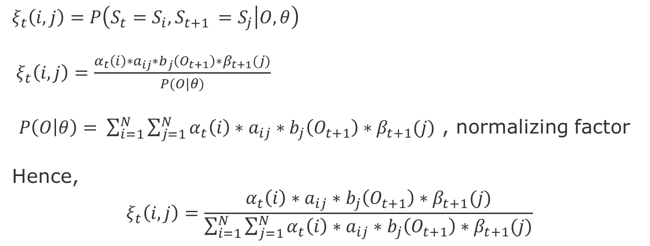
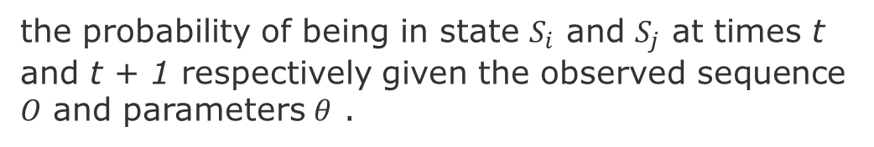
Now how to aggregate these estimates iteratively?
the probability of being in state $S_{i}$ and $S_{j}$ at times t and t + 1 respectively given the observed sequence $O$ and parameters $θ$ .
$$ξ_{t}\left(i,j\right)=P\left(S_{t}=S_{i}, S_{t+1 }=S_{j} | O, θ\right)$$
${ ξ}_{t}\left(i,j\right)=\frac{α_{t}\left(i\right)∗a_{ij}∗b_{j}\left(O_{t+1}\right)∗β_{t+1}(j)}{P(O|θ)}$
$P\left(O | θ\right)= \sum_{i=1}^{N}{\sum_{j=1}^{N}{α_{t}\left(i\right)∗a_{ij}∗b_{j}\left(O_{t+1}\right)∗β_{t+1}(j)}}$ , normalizing factor
Hence,
$${ ξ}_{t}\left(i,j\right)=\frac{α_{t}\left(i\right)∗a_{ij}∗b_{j}\left(O_{t+1}\right)∗β_{t+1}(j)}{\sum_{i=1}^{N}{\sum_{j=1}^{N}{α_{t}\left(i\right)∗a_{ij}∗b_{j}\left(O_{t+1}\right)∗β_{t+1}(j)}}}$$
Notes:
Introduce conditional operator P has two components P(C|C)

Slide 8
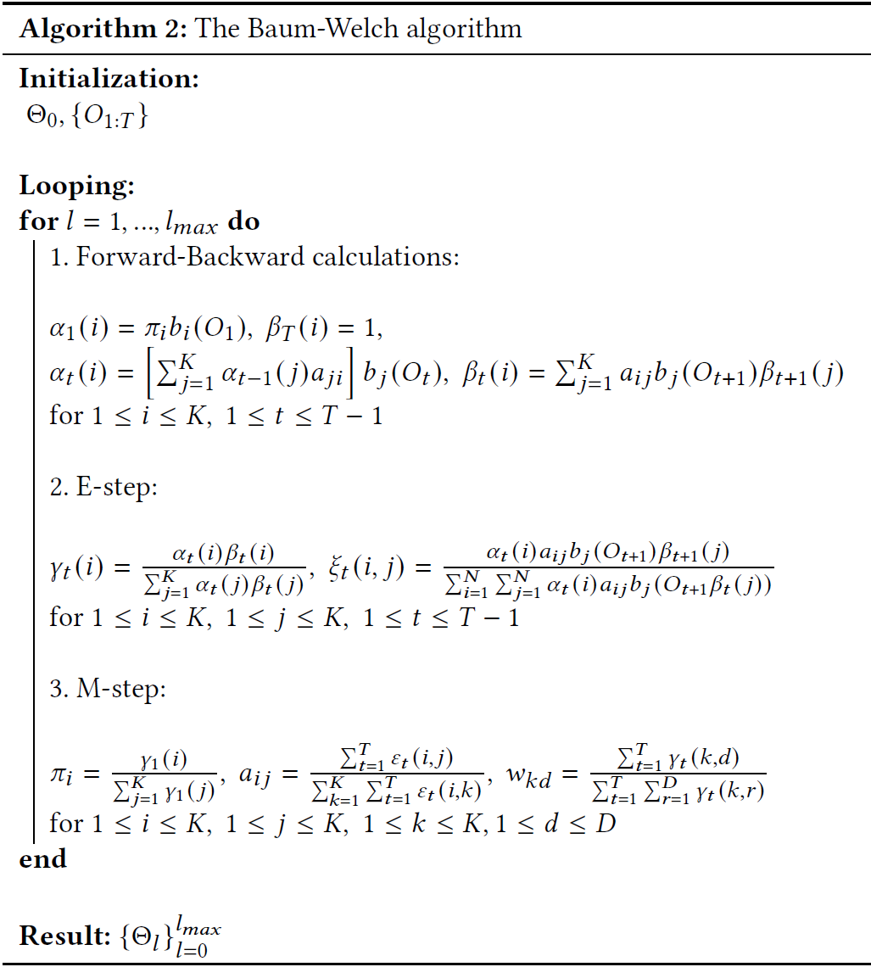
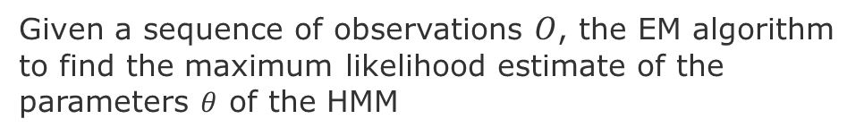
Baum-Welch Algorithm: Iterative Procedure
Given a sequence of observations $O$, the EM algorithm to find the maximum likelihood estimate of the parameters $θ$ of the HMM
Forward and Backward steps
Bayesian Updates
Update the HMM parameters

Slide 9
Example of a Hidden Markov Network

Slide 10
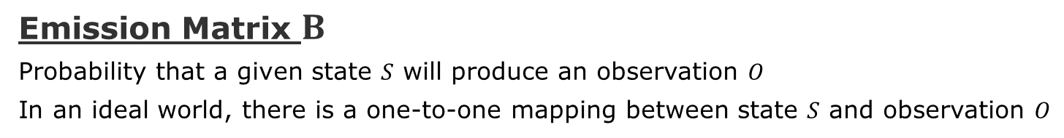
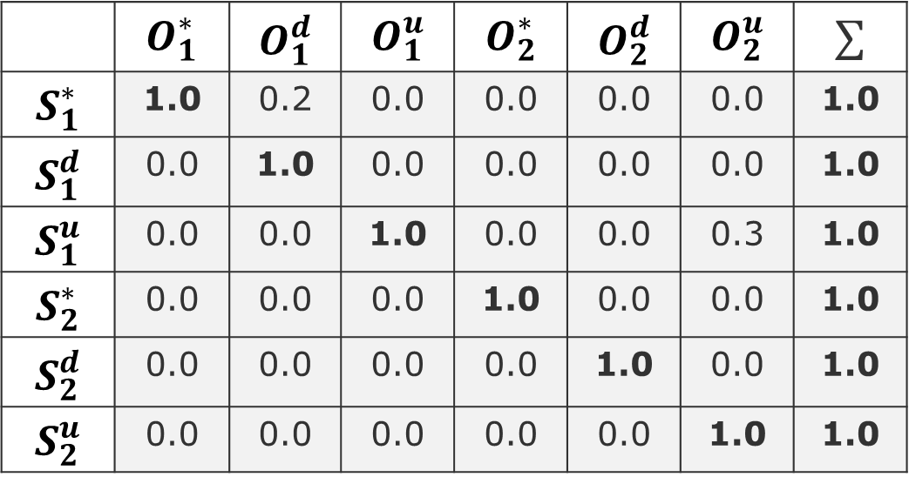
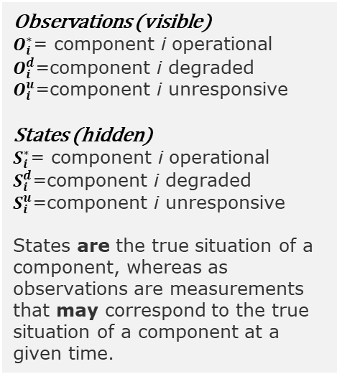
Example
Emission Matrix $B$
Probability that a given state $S$ will produce an observation $O$
In an ideal world, there is a one-to-one mapping between state $S$ and observation $O$
Observations
Observations (visible)
$O_{i}^{∗}$= component i operational
$O_{i}^{d}$=component i degraded
$O_{i}^{u}$=component i unresponsive
States (hidden)
$S_{i}^{∗}$= component i operational
$S_{i}^{d}$=component i degraded
$S_{i}^{u}$=component i unresponsive
States are the true situation of a component, whereas as observations are measurements that may correspond to the true situation of a component at a given time.
 | $$O_{1}^{∗}$$ | $$O_{1}^{d}$$ | $$O_{1}^{u}$$ | $$O_{2}^{∗}$$ | $$O_{2}^{d}$$ | $$O_{2}^{u}$$ | $$∑$$
$$S_{1}^{∗}$$ | 1.0 | 0.2 | 0.0 | 0.0 | 0.0 | 0.0 | 1.0
$$S_{1}^{d}$$ | 0.0 | 1.0 | 0.0 | 0.0 | 0.0 | 0.0 | 1.0
$$S_{1}^{u}$$ | 0.0 | 0.0 | 1.0 | 0.0 | 0.0 | 0.3 | 1.0
$$S_{2}^{∗}$$ | 0.0 | 0.0 | 0.0 | 1.0 | 0.0 | 0.0 | 1.0
$$S_{2}^{d}$$ | 0.0 | 0.0 | 0.0 | 0.0 | 1.0 | 0.0 | 1.0
$$S_{2}^{u}$$ | 0.0 | 0.0 | 0.0 | 0.0 | 0.0 | 1.0 | 1.0
States
However, the states are hidden, so they might map to any observation. For simplicity here, we are assuming a same number of states and observations

Slide 11
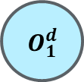
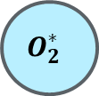
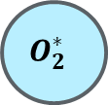
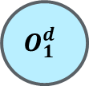
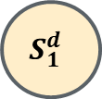
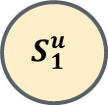
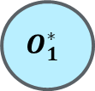
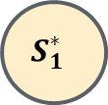
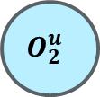
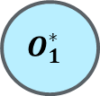
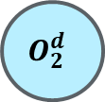
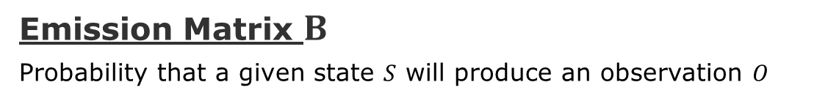
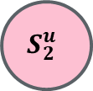
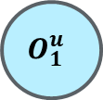

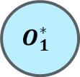

Example
Emission Matrix $B$
Probability that a given state $S$ will produce an observation $O$
$$S_{1}^{∗}$$
Intermittent cycle
$$O_{1}^{∗}$$
$$O_{1}^{d}$$
Observations
 | $$O_{1}^{∗}$$ | $$O_{1}^{d}$$ | $$O_{1}^{u}$$ | $$O_{2}^{∗}$$ | $$O_{2}^{d}$$ | $$O_{2}^{u}$$ | $$∑$$
$$c$$ | 0.8 | 0.2 | 0.0 | 0.0 | 0.0 | 0.0 | 1.0
$$S_{1}^{d}$$ | 0.1 | 0.6 | 0.1 | 0.0 | 0.2 | 0.0 | 1.0
$$S_{1}^{u}$$ | 0.0 | 0.0 | 0.7 | 0.0 | 0.0 | 0.3 | 1.0
$$S_{2}^{∗}$$ | 0.0 | 0.0 | 0.0 | 0.9 | 0.1 | 0.0 | 1.0
$$S_{2}^{d}$$ | 0.0 | 0.0 | 0.0 | 0.1 | 0.6 | 0.3 | 1.0
$$S_{2}^{u}$$ | 0.2 | 0.0 | 0.0 | 0.1 | 0.0 | 0.7 | 1.0
$$S_{1}^{d}$$
$$O_{1}^{∗}$$
$$O_{1}^{d}$$
$$O_{1}^{u}$$
$$O_{2}^{d}$$
States
$$S_{1}^{u}$$
$$S_{2}^{u}$$
$$O_{1}^{u}$$
$$O_{2}^{∗}$$
$$O_{1}^{∗}$$
$$O_{2}^{u}$$
$$O_{2}^{∗}$$
Effect of Failure Masking

Slide 12
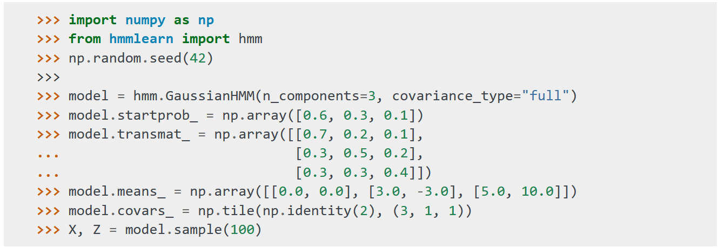
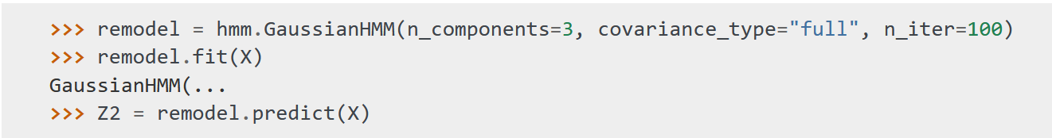
Tool: Hmm Learn
Initializing and Sampling a Model
Learning

Slide 13
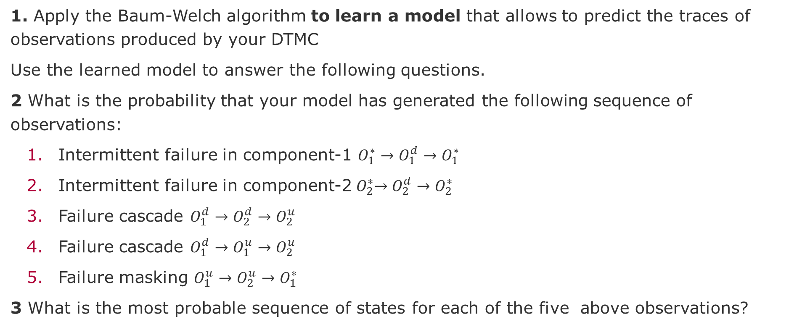
Task-1 - Warmup
1. Apply the Baum-Welch algorithm to learn a model that allows to predict the traces of observations produced by your DTMC
Use the learned model to answer the following questions.
2 What is the probability that your model has generated the following sequence of observations:
Intermittent failure in component-1 $O_{1}^{∗}→O_{1}^{d}→O_{1}^{∗}$
Intermittent failure in component-2${ O}_{2}^{∗}→O_{2}^{d}→O_{2}^{∗}$
Failure cascade $O_{1}^{d}→O_{2}^{d}→O_{2}^{u}$
Failure cascade $O_{1}^{d}→O_{1}^{u}→O_{2}^{u}$
Failure masking $O_{1}^{u}→O_{2}^{u}→O_{1}^{∗}$
3 What is the most probable sequence of states for each of the five above observations?

Slide 14
Task-2
Apply the Baum-Welch algorithm to learn a model for your mRubis scenario
Generate a sequence of observations from your DTMC that correspond to the three scenarios:
Intermittent failure
Failure cascade
Failure masking
Use your learned model to
Compute the probability of each scenario
Estimate the sequence of states that most probably generated each observation trace

Slide 15
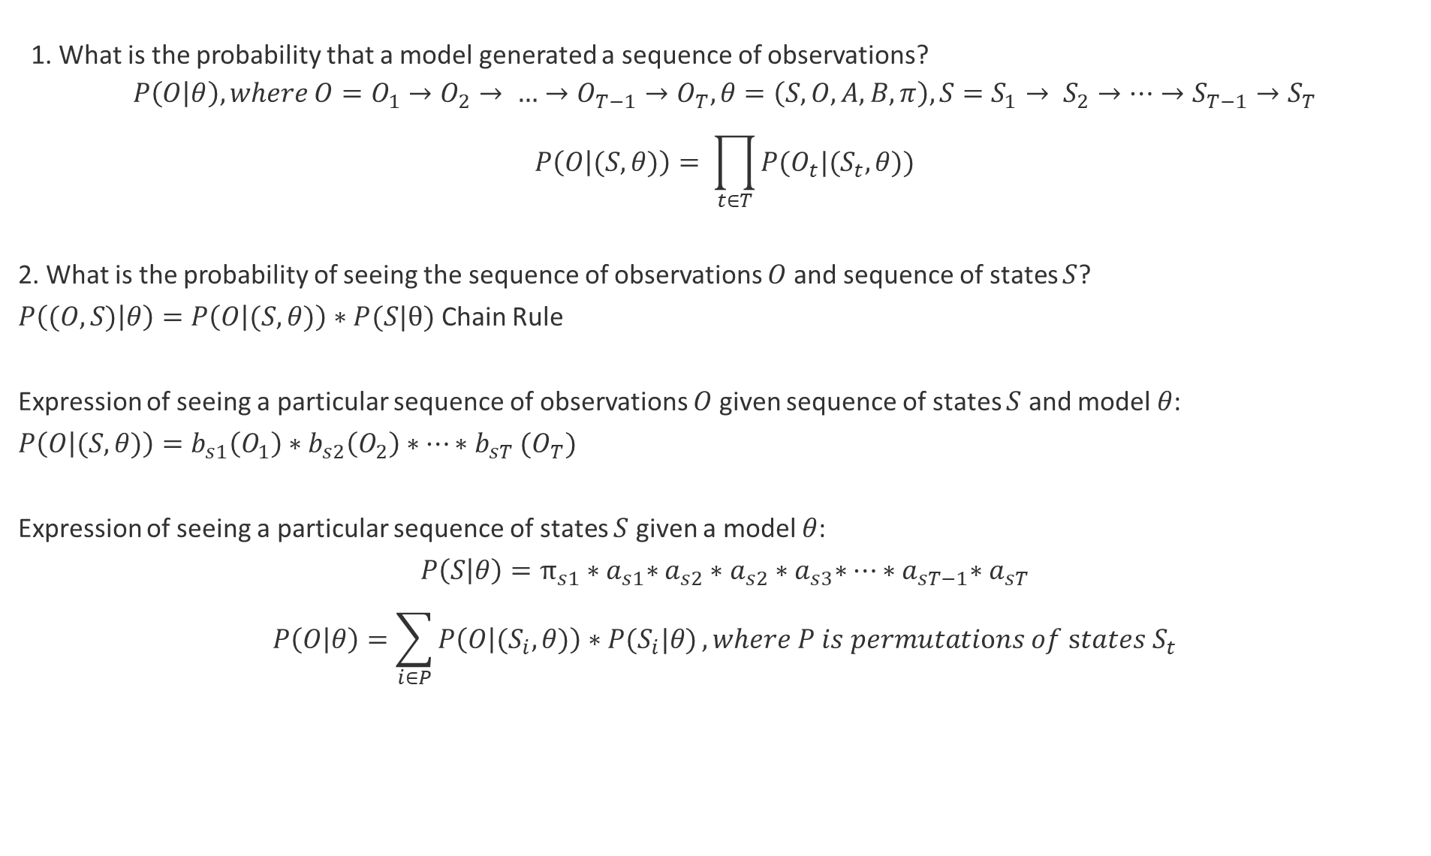
Some derivations
1. What is the probability that a model generated a sequence of observations?
$$P\left(O | θ\right), where O=O_{1}→O_{2}→ …→O_{T−1}→O_{T},θ=\left(S,O,A,B,π\right),S=S_{1}→ S_{2}→…→S_{T−1}→S_{T}$$
$$P\left(O | (S,θ)\right)= \prod_{t∈T}{P(O_{t}|{(S}_{t},θ))}$$
2. What is the probability of seeing the sequence of observations $O$ and sequence of states $S$?
$P\left((O,S) | θ\right)=P\left(O | (S,θ)\right)∗P(S|θ)$ Chain Rule
Expression of seeing a particular sequence of observations $O$ given sequence of states $S$ and model $θ$:
$P\left(O | (S,θ)\right)=b_{s1}\left(O_{1}\right)∗b_{s2}\left(O_{2}\right)∗…{∗b}_{sT}(O_{T})$
Expression of seeing a particular sequence of states $S$ given a model $θ$:
$$P\left(S | θ\right)=π_{s1}{∗a}_{s1}∗a_{s2}∗a_{s2}{∗a}_{s3}∗…{∗a}_{sT−1}{∗a}_{sT}$$
$$P\left(O | θ\right)=\sum_{i∈P}{P\left(O | {(S}_{i},θ)\right)∗P(S_{i}|θ)}, where P is permutations of states S_{t}$$

Slide 16
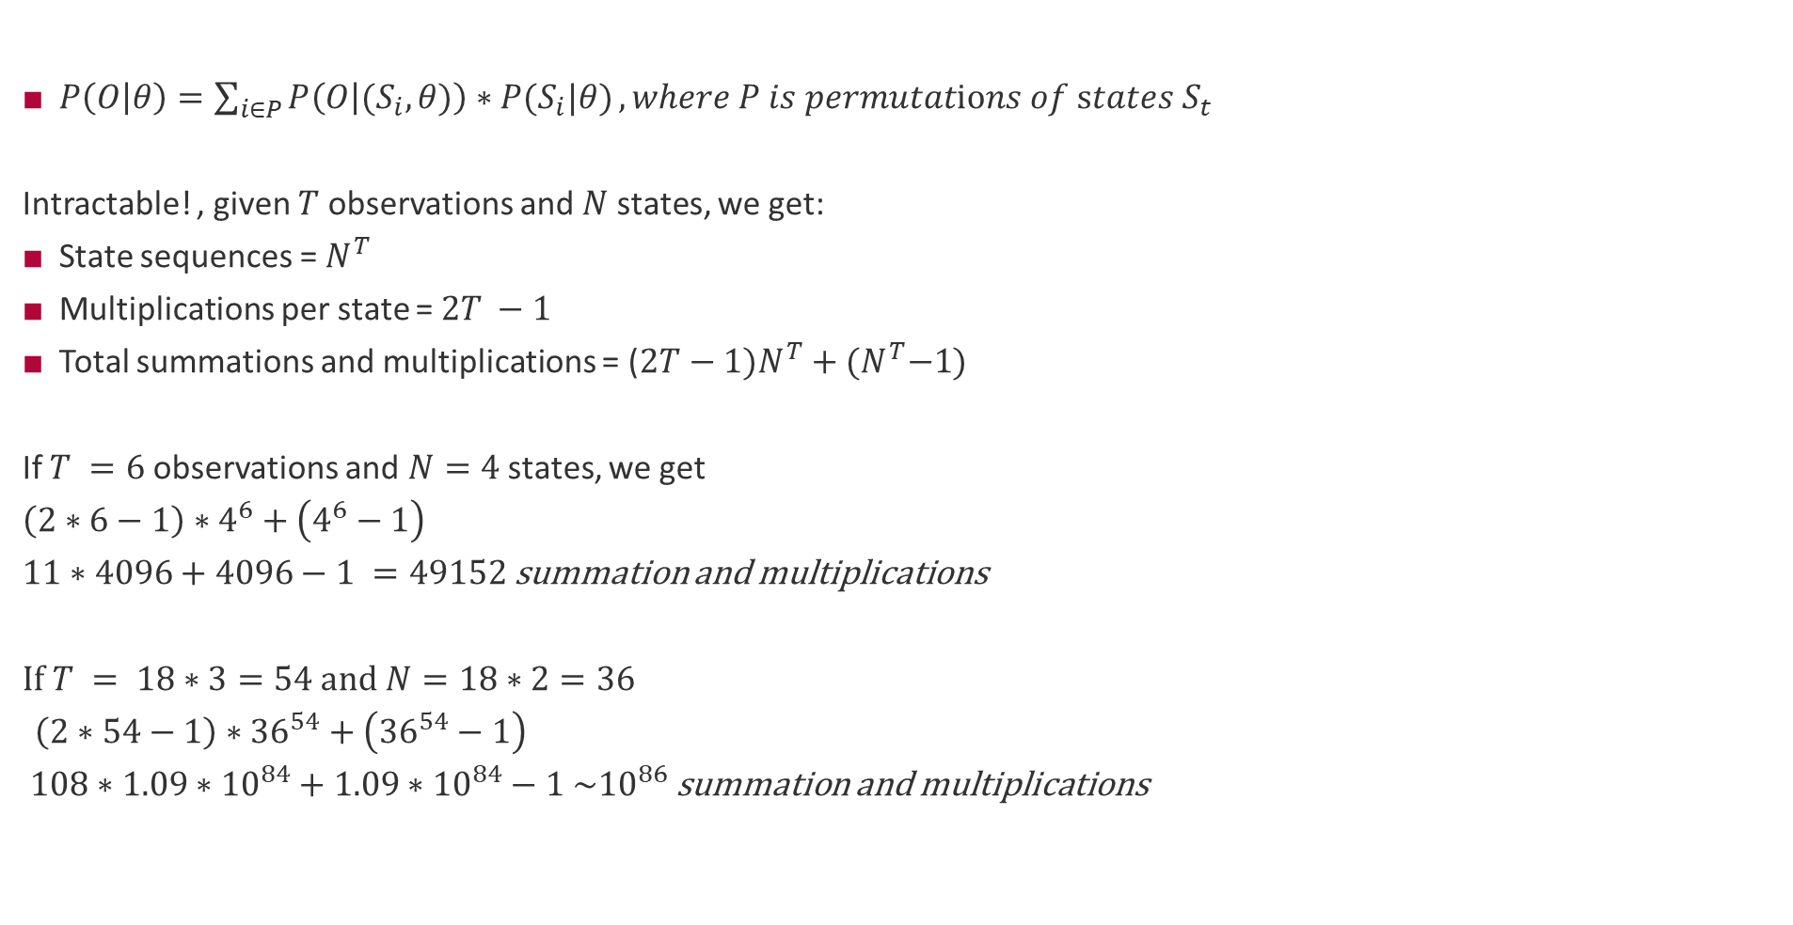
Computing $P(O|θ)$
$P\left(O | θ\right)=\sum_{i∈P}{P\left(O | {(S}_{i},θ)\right)∗P(S_{i}|θ)}, where P is permutations of states S_{t}$
Intractable! , given $T$ observations and $N$ states, we get:
State sequences = $N^{T}$
Multiplications per state = $2T −1$
Total summations and multiplications = ($2T−1)N^{T}+{(N}^{T}−1)$
If $T =6$observations and $N=4$ states, we get
$$\left(2∗6−1\right)∗4^{6}+\left(4^{6}−1\right)$$
$11∗4096+4096−1 =49152$ summation and multiplications
If $T = 18∗3=54$ and $N=18∗2=36$
$\left(2∗54−1\right)∗{36}^{54}+\left({36}^{54}−1\right)$ $108∗1.09∗{10}^{84}+1.09∗{10}^{84}−1 \sim {10}^{86}$ summation and multiplications

Slide 17
Additional Materials on HMMs
Lectures
Prof. Donald Patterson https://www.youtube.com/watch?v=J_y5hx_ySCg&list=PLix7MmR3doRo3NGNzrq48FItR3TDyuLCo
Prof. Pieter Abeel -https://www.youtube.com/watch?v=9dp4whVQv5s&pbjreload=101
Prof. Daniel Klein - https://www.youtube.com/watch?v=OdQoRGRPmj8
Blog - Short tutorials:
Introduction to Hidden Markov Model
Forward and Backward Algorithm in Hidden Markov Model
Derivation and implementation of Baum Welch Algorithm for Hidden Markov Model
Implement Viterbi Algorithm in Hidden Markov Model using Python and R
Tutorial (Text)
https://web.stanford.edu/~jurafsky/slp3/A.pdf
https://web.ece.ucsb.edu/Faculty/Rabiner/ece259/Reprints/tutorial%20on%20hmm%20and%20applications.pdf

Slide 18
End

Slide 19
Supervisory Component

